Slide 1
Fake News Identification
Final Project for the Data Analysis Bootcamp

Slide 2
CONTEXT
01
APPROACH
02
TABLE OF CONTENTS
ACCURACY
03
SNEAK PEEK
04
How we define fake news for this project
How did the approach to build the model look
How well does the model predict fake news
A quick demo of the final project output

Slide 3
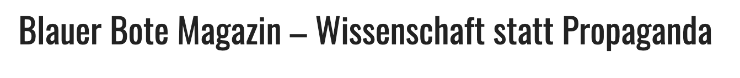





Context
Fake news sources (non-exhaustive)
We define fake news for this project as news from sources that are generally considered to be misleading.
We classify news as Fake or Real based on their source
Real news sources (non-exhaustive)

Slide 4
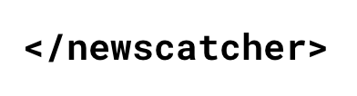






Approach
Data Scraping
Data Cleaning
Modelling
Visualisation
Mixed use of API scraping and BeautifulSoup to complement available datasets.
Basic cleaning and labelling with pandas and regex.
Additional cleaning of stop words using NLTK.
Exclusively used sklearn functionality.
Tfidf-Vectorizer to encode clean news articles.
PassiveAggressiveClassifier to create the actual model.
Visualization of the prediction tool using the Streamlit library

Slide 5
Data Structure
3,988
Articles in an independent data set compiled from Kaggle & additionally scraped data
Final data set
52,403 labelled articles
44,185
4,230
English articles from the University of Victoria, Canada*
German articles scrapped from the web
*) Ahmed H, Traore I, Saad S. (2018), Ahmed H, Traore I, Saad S. (2017)

Slide 6
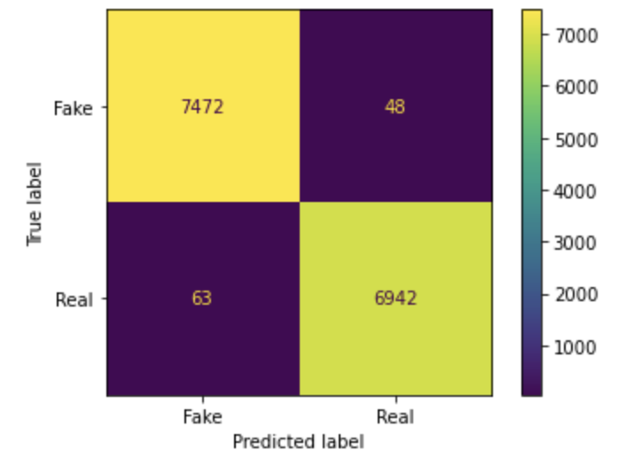
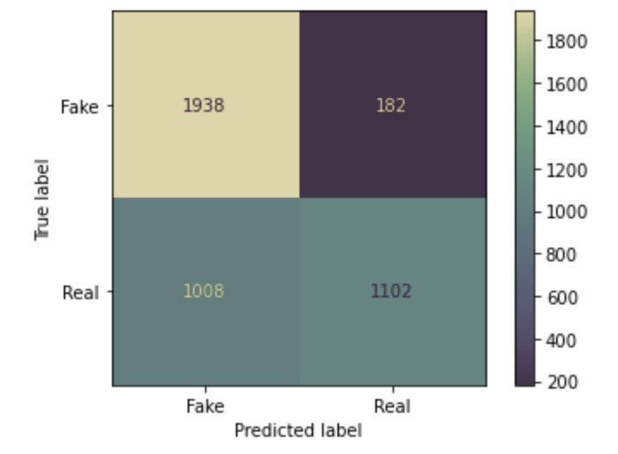
Accuracy
Accuracy for the initial testing data
99.26%
71.37%
Accuracy for the independent data set

Slide 7
THANKS EVERYONE!

